Slide 1

Gavin, JC, Vanessa

Slide 2




Notes:
udacity analytics presenting to udacity product managers

Slide 3
Background
Udacity home page had two calls to action:
Start free trial
Enter credit card #
Enrolled (free trial)
Paid course
version
14 day access to full version of the course
Automatically charged after 14 days (unless cancel first)
Access course materials
Free course version
Limited access: videos and quizzes. No coaching support, verified certificate, or final project for feedback.
Notes:
Vanessa - flowchart

Slide 4
Experiment Overview
Udacity test:
Enrolled (free trial)
Paid course
version
> 5
Start free trial
Input time
(committed to learning)
< 5
Suggest free course version
Free course version
Messaging about greater time commitment necessary for success
Notes:
Vanessa - flowchart

Slide 5
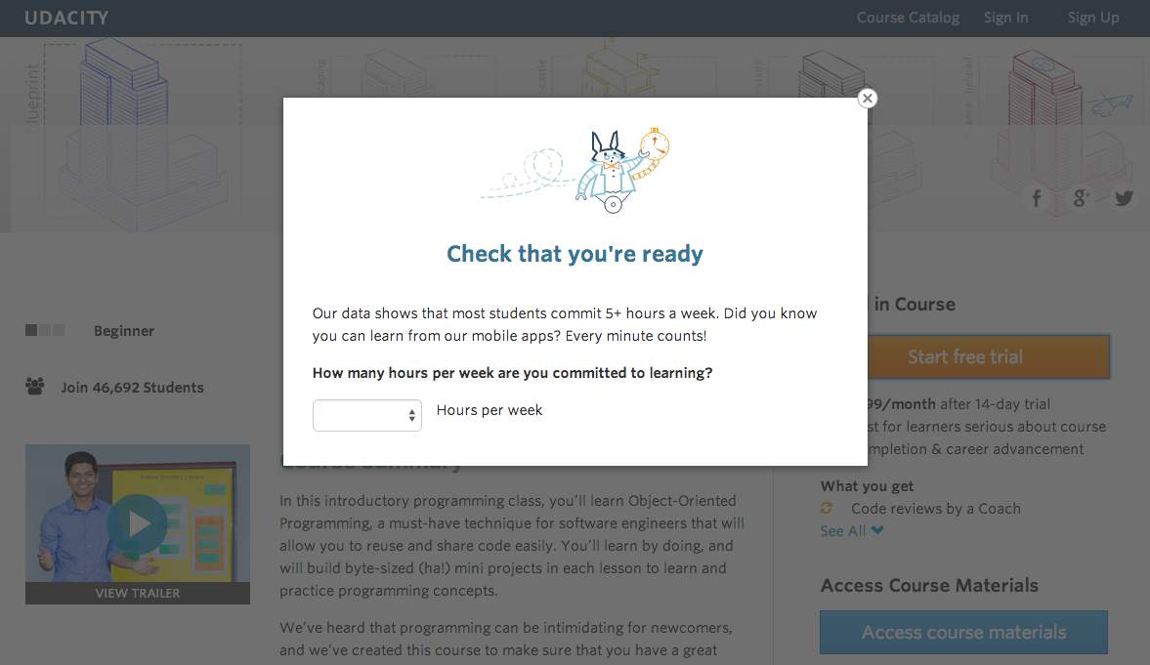
Notes:
Vanessa - flowchart

Slide 6
Expectations
Students will have better expectations about time commitment upfront
Reduces the number of frustrated students who leave free trial (churn)
Only minimally reduces the number of students to continue past the free trial
Improves overall student experience & coaches’ capacity to support students
Increases Retention
Notes:
Vanessa
For test we expect a difference between control group and experiment group, specifically we expect…

Slide 7
Metric Choice
What we choose to measure for this experiment:
Gross Conversion
Retention
Net Conversion
considers change in enrollment rate
considers rate of students leaving during free trial
considers rate of students becoming paid users
Notes:
JC
Metric Choice: GC & NC
Ignore Retention because contains untracked / confounding factors
Other metrics: Number of cookies, Number of user-ids and Number of clicks (chose to ignore these because do not measure anything of significance)

Slide 8
Metric Choice
Retention
Gross
Conversion
Net
Conversion
Enrolled (free trial)
Paid course
version
> 5
Start free trial
Input time
< 5
Suggest free course version
Free course version
Click Through
Probability
Notes:
JC
Metric Choice: GC & NC
Ignore Retention because contains untracked / confounding factors
Other metrics: Number of cookies, Number of user-ids and Number of clicks (chose to ignore these because do not measure anything of significance)

Slide 9
Sizing
Find minimum sample size (pageviews) required to be confident we are detecting meaningful differences in our metrics between the experiment and control groups
Gross Conversion
Retention
Net Conversion
Requires 645,875 pageviews to power test for Gross Conversion
Requires 4,741,213 pageviews to power test for Retention
Requires 685,325 pageviews to power test for Net Conversion
Notes:
baseline conversion for each metric & minimum detectable effect of 1%

Slide 10
Exposure & Duration
What percentage of traffic should be diverted to experiment? How long will the experiment take to complete at this exposure level?
100 % Exposure
75 % Exposure
50 % Exposure
At 40,000 pageviews/day,
test will run 18 days
At 40,000 pageviews/day,
test will run 23 days
At 40,000 pageviews/day,
test will run 35 days
Notes:
Vanessa

Slide 11
Variability — Trial Group (10, 000) vs All Udacity visits
Metric | Metric Value | Why | If available / possible
Gross Conversion | Approximation | Unique User Enrollments from Duplicate Clicks on Start Trial | Use all Udacity visits data
Net Conversion | Approximation | Unique User Payments from Duplicate Clicks on Start Trial | Use all Udacity visits data
Retention | Accurate | Unique User Payments from Unique User Enrollments
Notes:
JC

Slide 12
Sanity Checks:
Balanced Distribution in Control & Experiment Group
Metric | Observed Experiment Group Probability | Expected Probability | Experiment Test
Pageviews | 0.499360 | 0.498820 - 0.501180 | Passed
Clicks | 0.499533 | 0.495884 - 0.504116 | Passed
Enrollments | 0.474889 | 0.488457 - 0.511543 | Failed but expected trend
Payments | 0.488939 | 0.484462 - 0.515538 | Passed
Notes:
JC

Slide 13
Practical & Statistical Significance
RECOMMENDATION Do not launch
Find other ways
Statistically + Practically Significant
-0.02 0.0116
Statistically + Practically
Not Significant
Big drop in paid users !!!
-0.0119 0.0018
Gross Conversion
Net Conversion
-0.01 -0.0075 0 0.0075 0.01
Notes:
JC

Slide 14
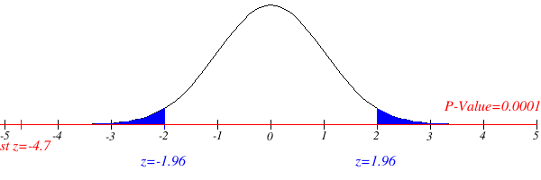
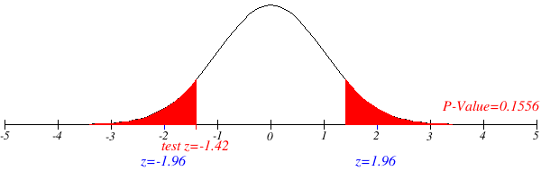
Significance Tests
Notes:
Gavin

Slide 15
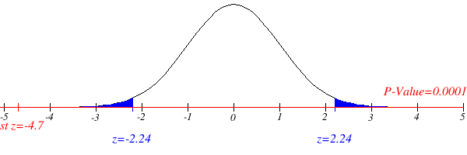
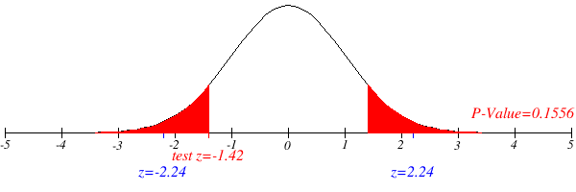
Significance Tests (with Bonferroni Correction)
Notes:
Gavin

Slide 16
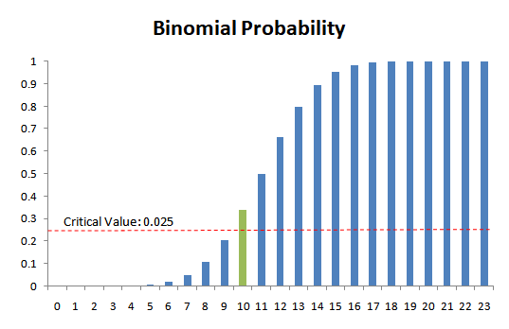
Sign Test
Gross
Conversion
Improved
4 days
Net
Conversion
Improved
10 days
Notes:
Gavin
Sign test: Two-tail Binomial Test

Slide 17
Follow Up Experiment
Udacity test:
No discount 14 day free trial
Start free trial
Enrolled
High Discount in day 3 - 5 in 14 day free trial
Paid course
version
Moderate Discount in day 10 - 12 in 14 day free trial
Notes:
Gavin

Slide 18
Follow Up Experiment
Expectation : Increased Retention
Invariant Metrics: Pageview, Clicks, and User-ids
Evaluation Metrics : Retention, Net Conversion
Success Criteria : A statistically and practically significant increase in Retention and Net Conversion would indicate that the change is successful.
Notes:
Gavin

Slide 19
THANK YOU

